Slide 1




Parental Help
Team
Date of Presentation:09/04/2022
Thanks
Scope
Introduction
Dates
Content
ER Diagram
Parental Help
Post Graduate Diploma In Advance Computing(PG-DAC)
September-2021

Slide 2
Project Team
Aditya Kadam -210943120006
Abhishek Jawane - 210943120035
Lalit Khomane - 210943120049
Vrushabh Vaidya - 210943120116
Thanks
Team
Parental Help
Dates
Introduction
Scope
Content
ER Diagram

Slide 3
Contents
Introduction
Problem definition and proposed solution
Scope of project
Hardware and software requirements
Timeline duration and expected deliverables
Dates
Team
Thanks
Scope
Introduction
ER Diagram
Content
Parental Help

Slide 4
Introduction
A software product which provides solution for childcare, baby tips, baby products,Doctors, Vaccination centers,babysitters etc.
It provides Home Services On Demand by Providing childcare professional.One stop for baby care.
Content
Thanks
Team
Dates
Scope
Introduction
ER Diagram
Parental Help

Slide 5
Problem definition and Proposed Solution
The idea is to help people find the best services easily and provide the large base of individuals and small businesses and healthcare professionals with a platform to manage and grow their client network.
Parental Help is a platform that aims to effortlessly connect and serve a large local base of individuals with healthcare professionals.
Dates
Team
Thanks
Scope
Introduction
ER Diagram
Content
Parental Help

Slide 6
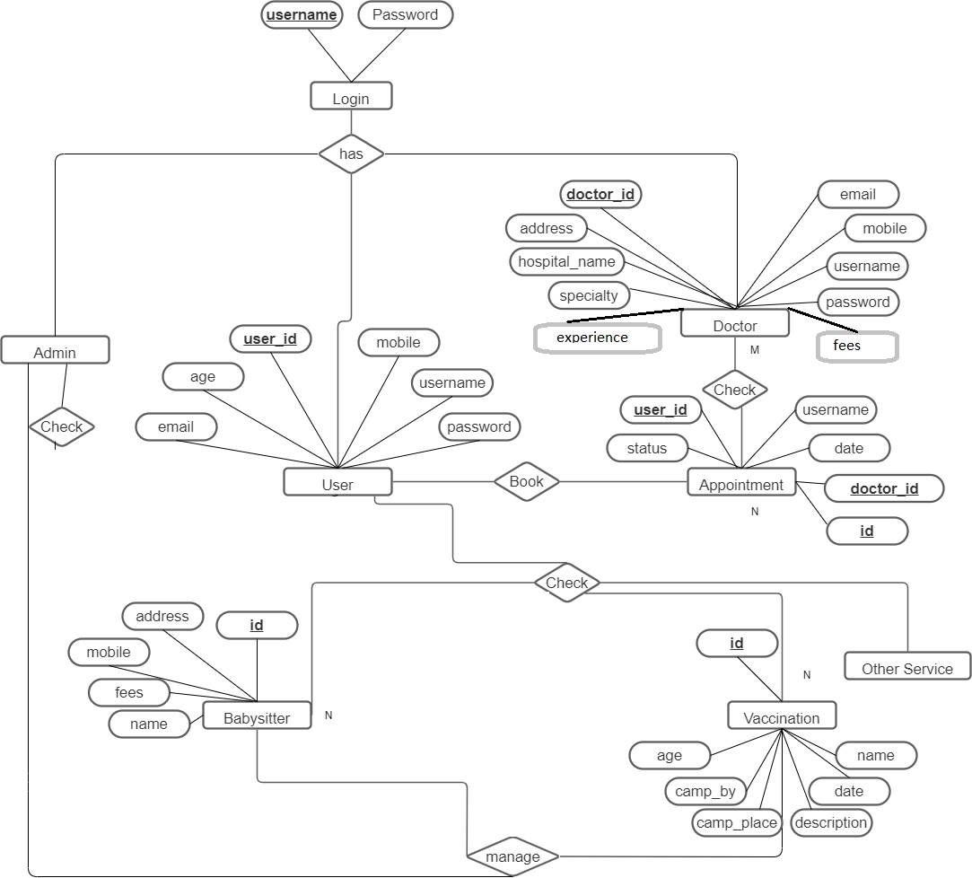
ER Diagram
Dates
Team
Thanks
Scope
Introduction
ER Diagram
Content
Parental Help

Slide 7


Software and Hardware Requirements
Software and Hardware Requirements
Front End-HTML ,CSS,JSP,JAVASCRPIT,BOOTSTRAP
Back End-SPRING BOOT
DataBase-MYSQL
Front End-
Back End-
DataBase-
Dates
Requisites
Team
Thanks
Scope
Introduction
ER Diagram
Content
_{Scope}
Parental Help

Slide 8


Future Scope
Payment Gateway
Time Binded Appointment Booking For Doctor And BabySitter
Thanks
Introduction
Team
Dates
Content
Future Scope
Parental Help

Slide 9
Thanks
Thank You!
Thanks
Introduction
Team
ER Diagram
Content
Parental Help

